Slide 1

This Is My Self-introduction, Including My Undergraduate Study, My Postgraduate Plan, And My Future Plan After Graduation.
Reporter：Zheng Meng
Date：2019-03-25

Slide 2
1
To introduce myself
CONTENTS
2
The Undergraduate life
3
Planing of postgraduate study
4
Planing of future carrer

Slide 3
01
PART
Basic information about me

Slide 4


To Introduce Myself
University：Wuhan University of Science and Technology
Professional：Computer Science And Technology
Score : 374
Age : 21
Telephone：132-127-61560
Self Assessment：
study hard
optimistic atitude
love to hlep those in need
strong team sprit

Slide 5
02
PART
The Undergraduate life

Slide 6
Honor in University
2015
2015
2018
Second-class scholarship of school
outstanding student leaders
Second-class scholarship of school

Slide 7
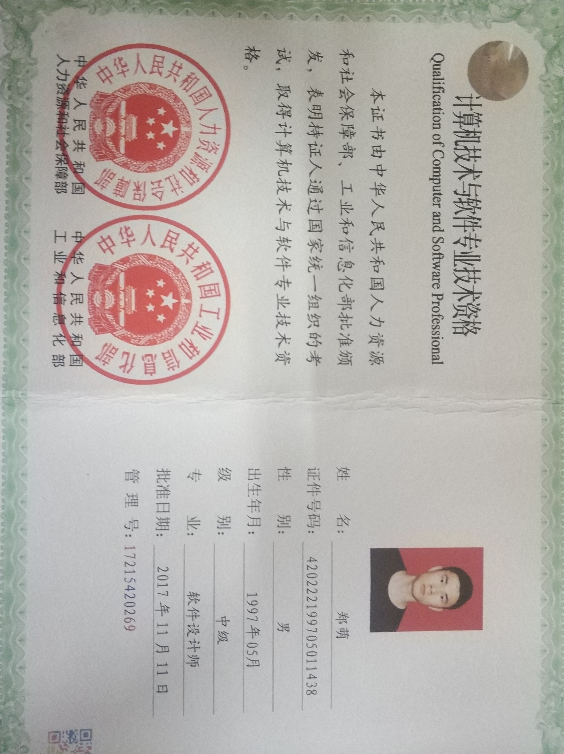
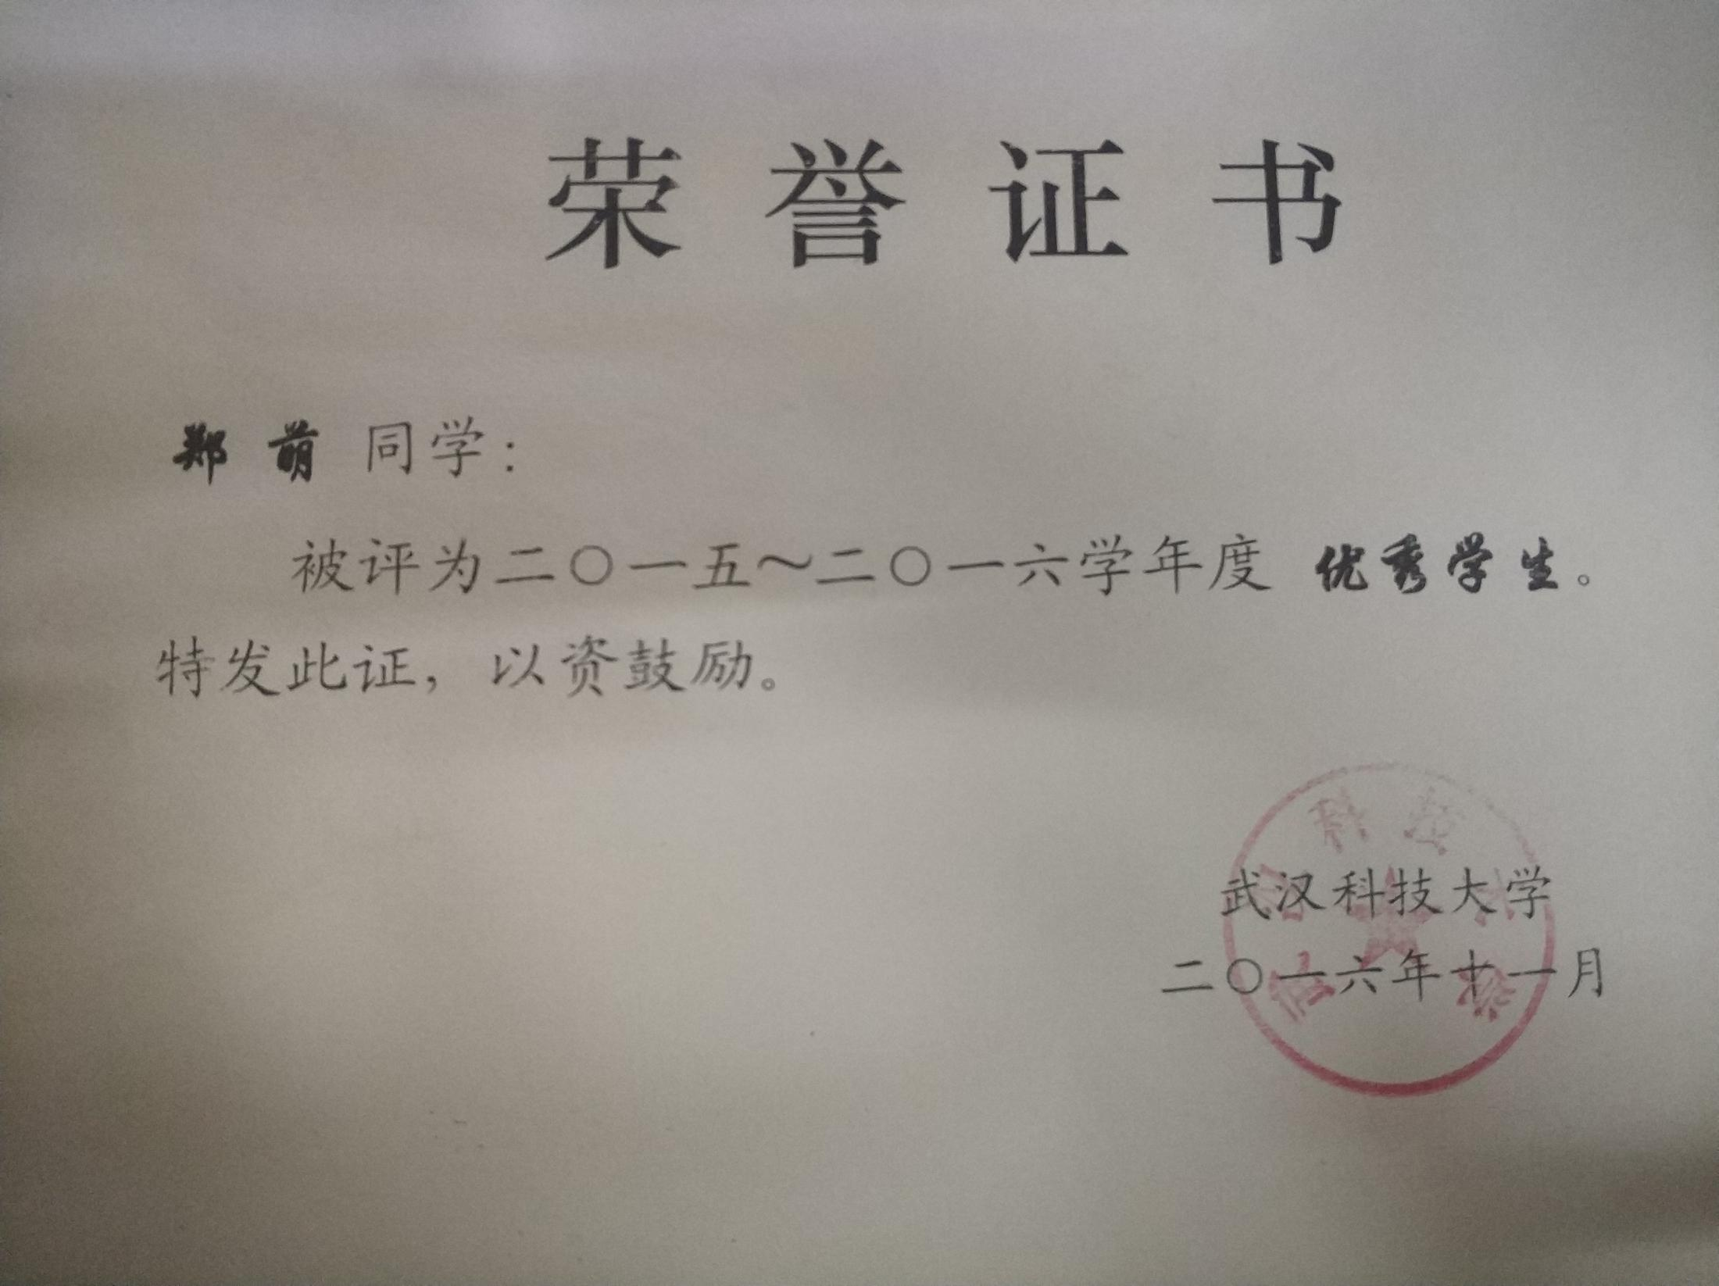
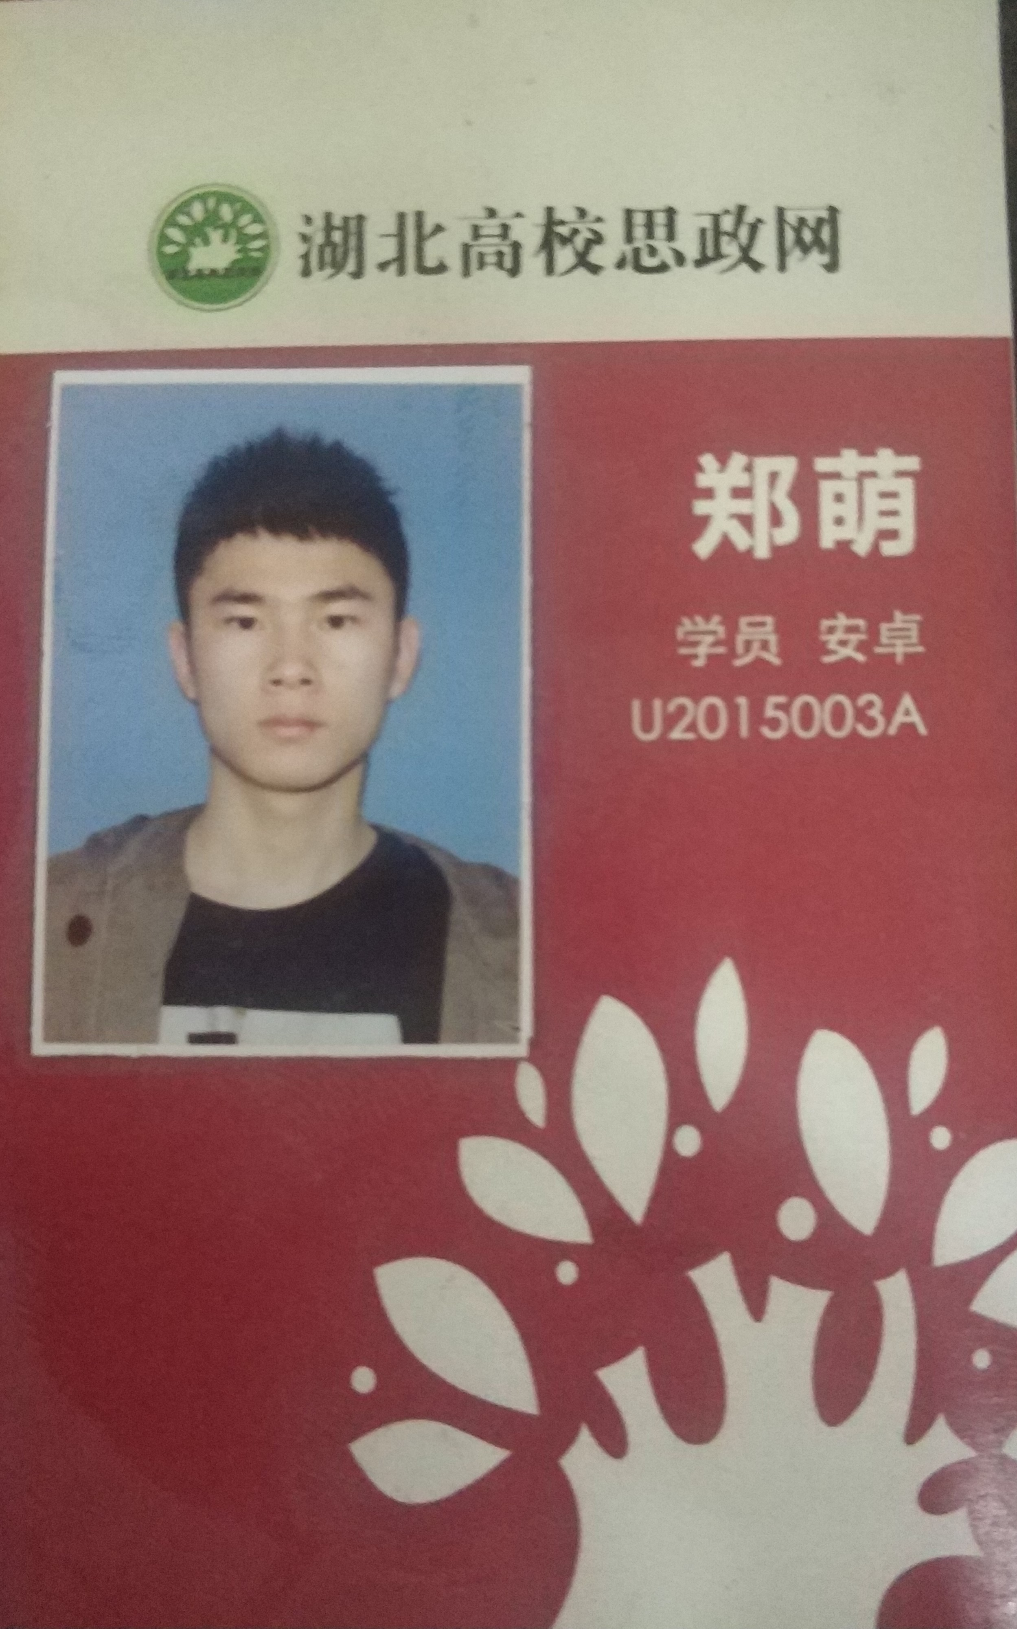
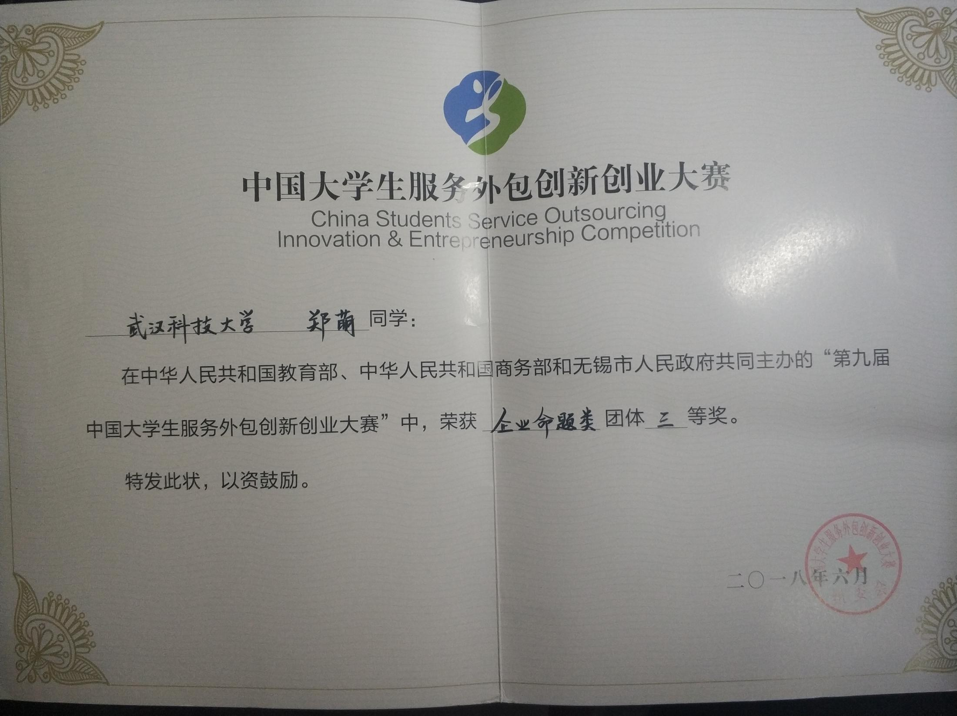
Content
2018. The 9th China colloge students service outsourcing innovation competion
second prize & Best choice Award
2016.

Slide 8
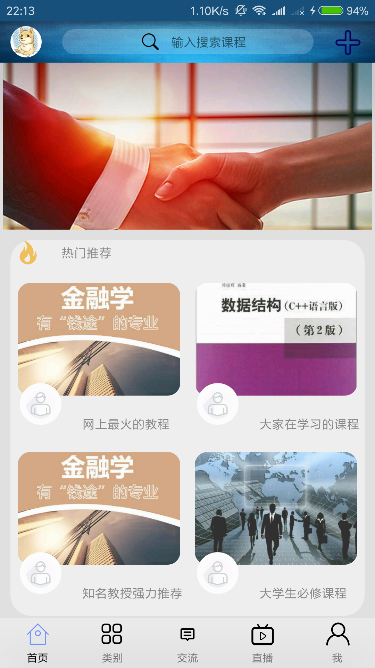
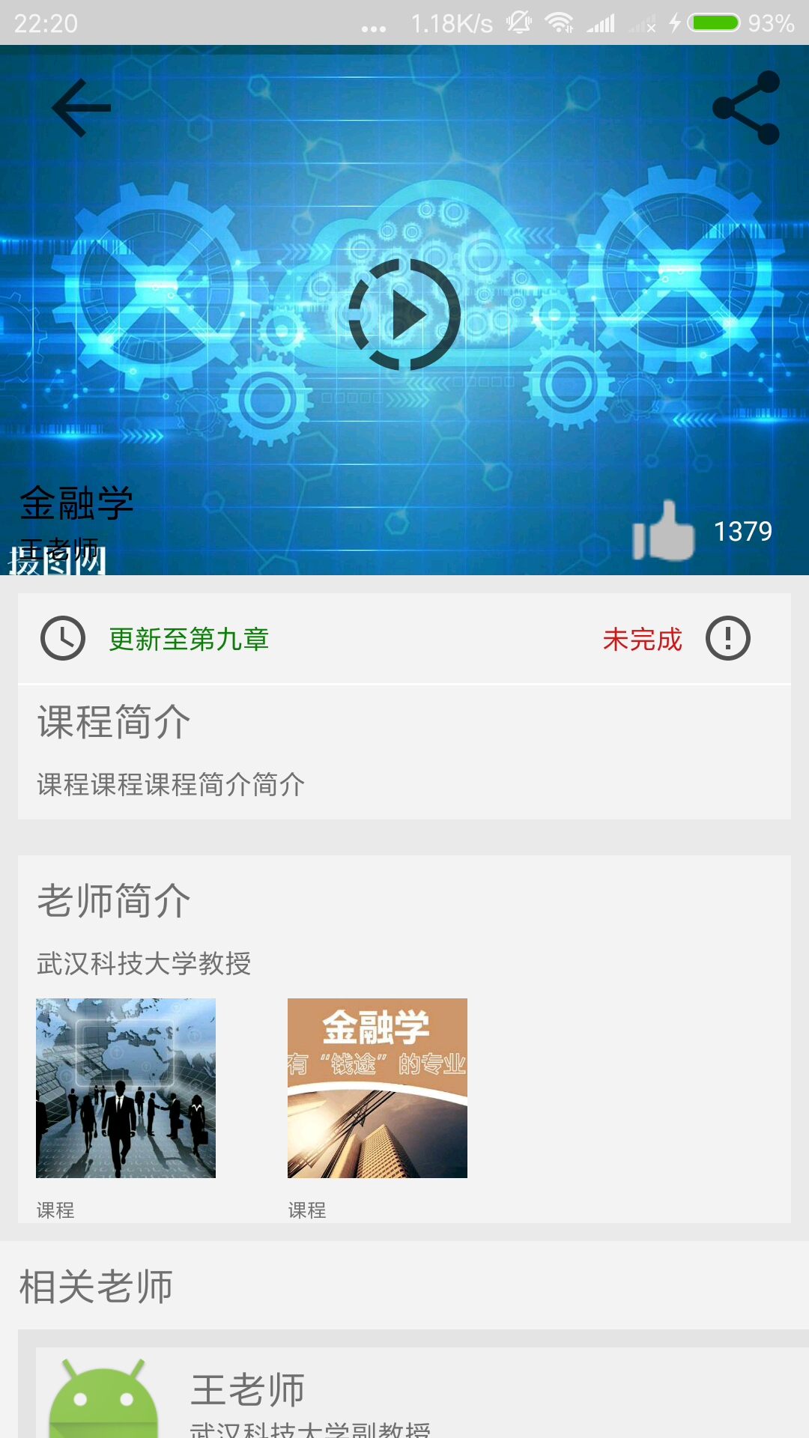
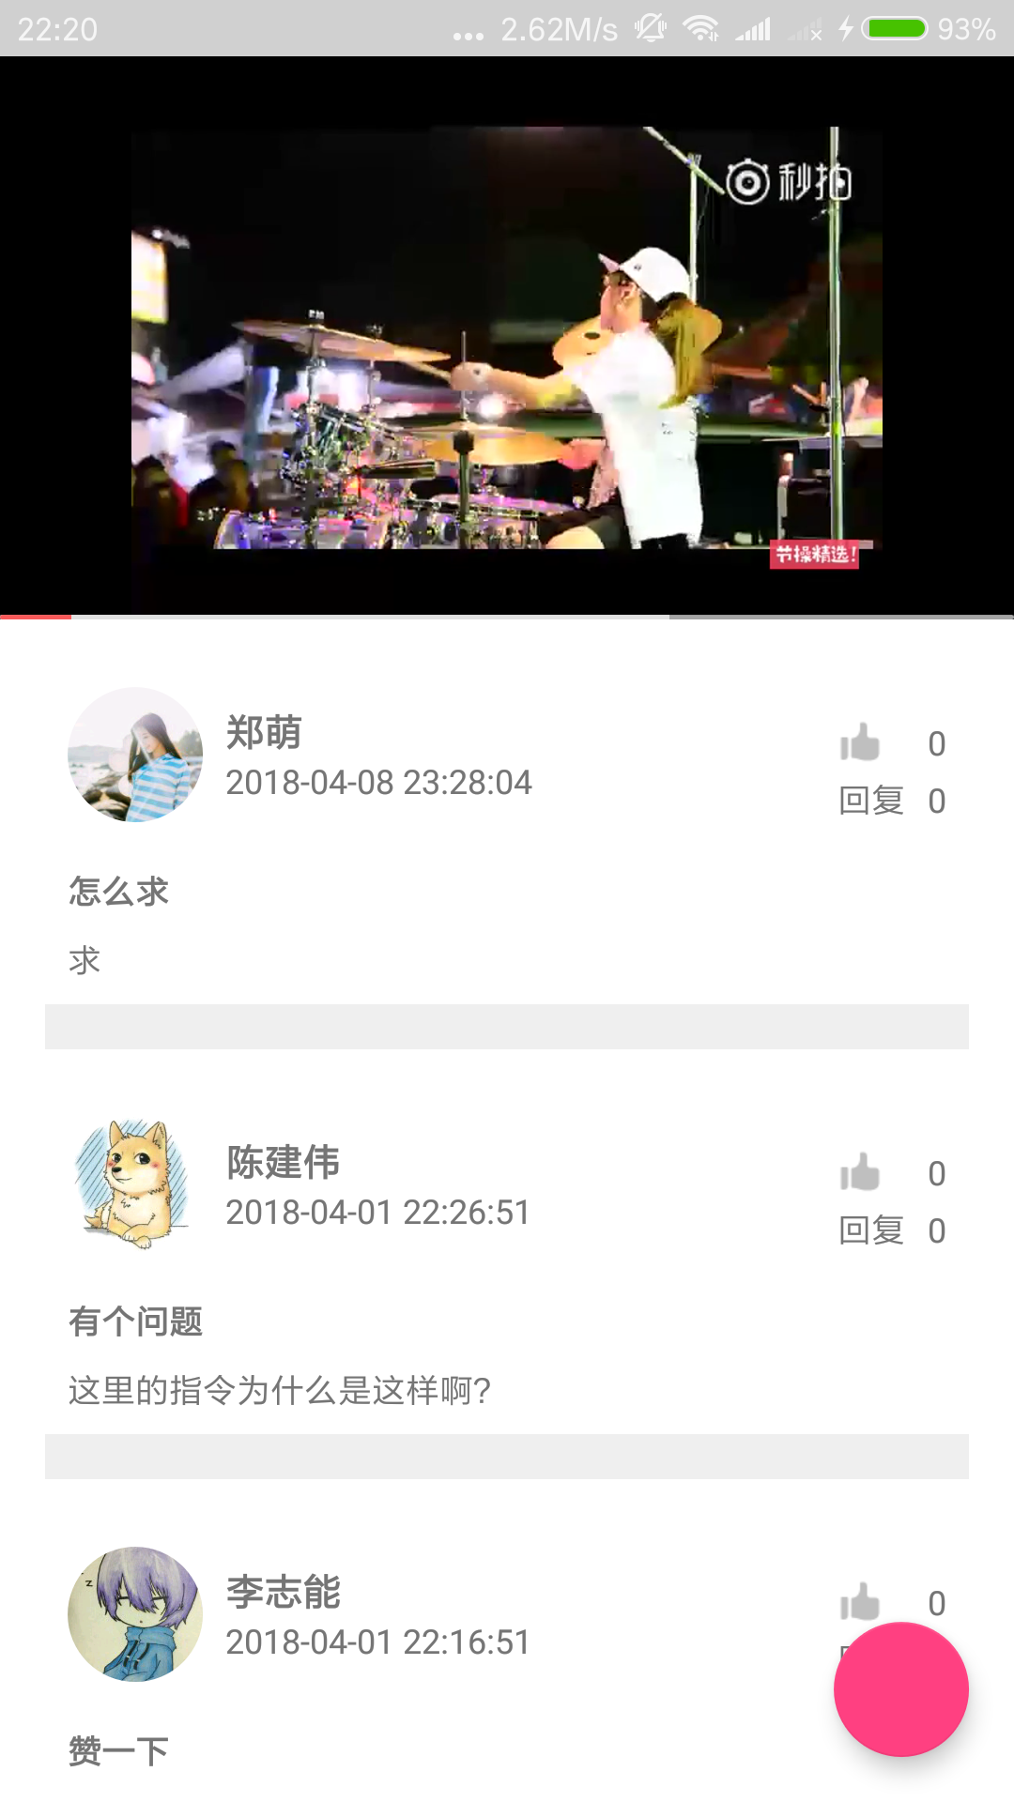
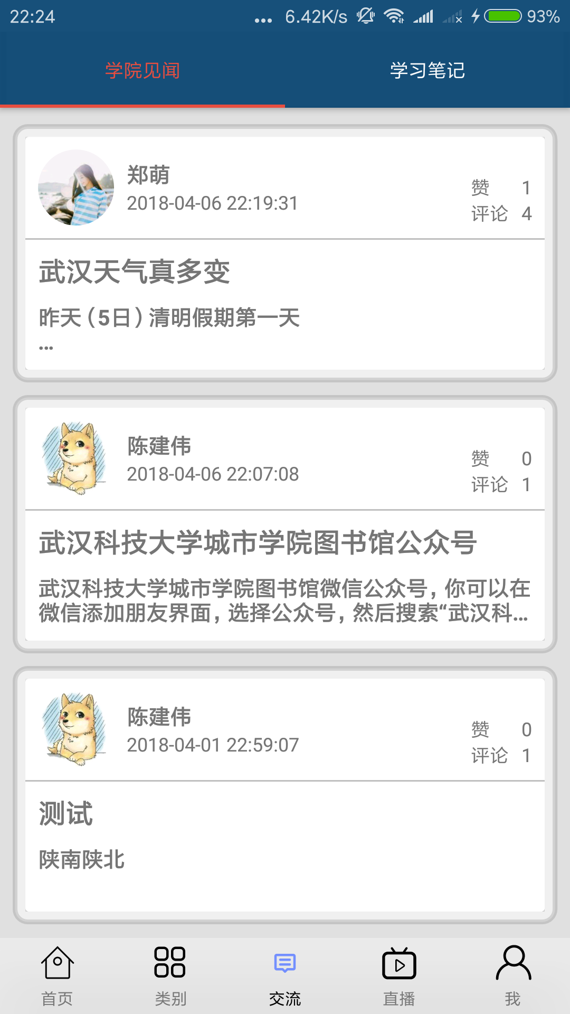
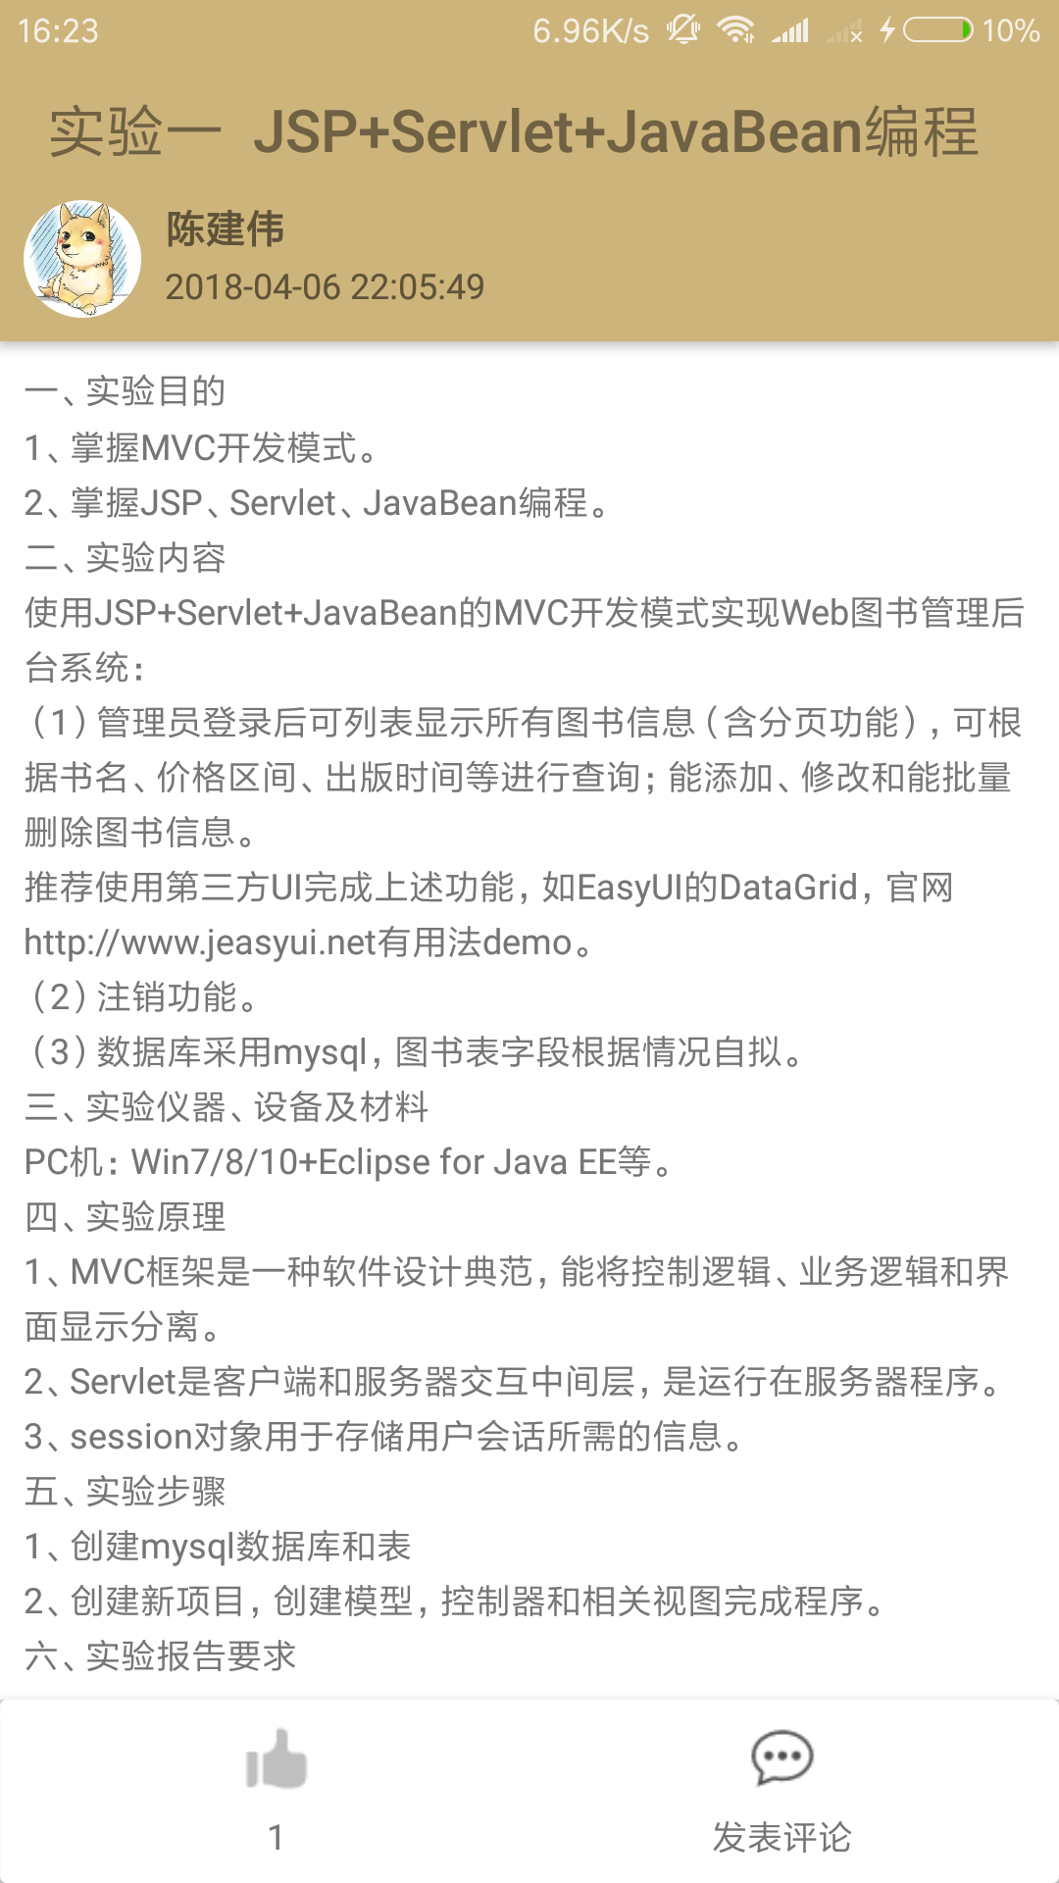
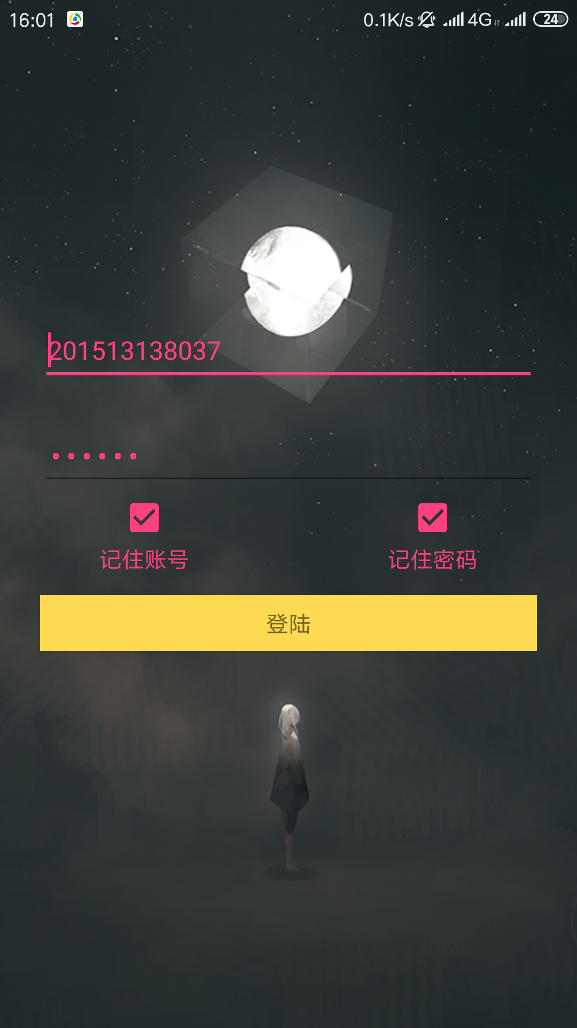
My Project
Cloud education

Slide 9
03
PART
Planning of postgraduate study

Slide 10
Planning of postgraduate study
The future is an era of big data
Study hard
PLAN
Big Data and Data MIning

Slide 11
04
PART
Planning of future carrer

Slide 12

Planning of future carrer
Alibaba research institute
Future Plan
Enjoy my life

Slide 13
I wish I could
study here.

Slide 14
This Is My Self-introduction, Including My Undergraduate Study, My Postgraduate Plan, And My Future Plan After Graduation.
Reporter：Zheng Meng
Date：2019-03-25

